Slide 1
Shapes and Colors
IMM 120 – September 10, 2018

Slide 2
Previously, in IMM120
Breaks
Sorry about Canvas

Slide 3
Today in IMM120
Basics of p5.js
Placing Things on a Screen
Drawing Shapes
Changing Colors
Tour of the World

Slide 4
p5.js skeleton
SETUP
DRAW
function setup() {
createCanvas(400, 400);
}
function draw() {
background(220);
}

Slide 5
Notes:
If you had to label this grid, how might you do that?

Slide 6
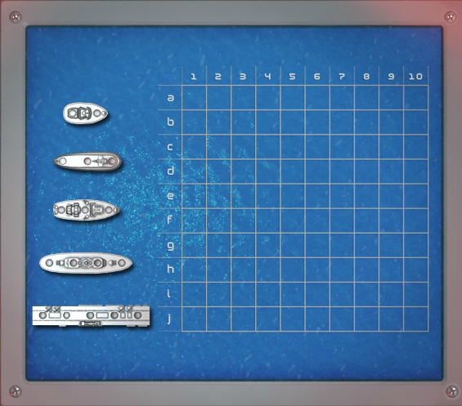

Slide 7
horizontal / x-axis

Slide 8
vertical / y-axis

Slide 9
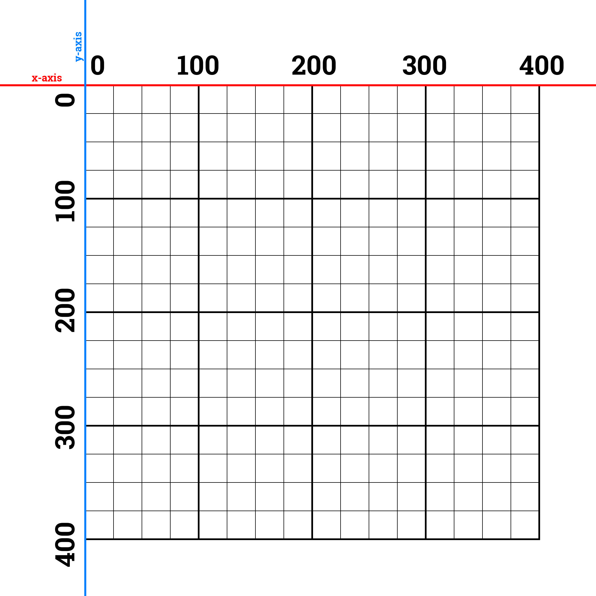

Slide 10
Coordinates
X then Y
(100, 200) is 100 pixels from the left, 200 pixels from the top

Slide 11
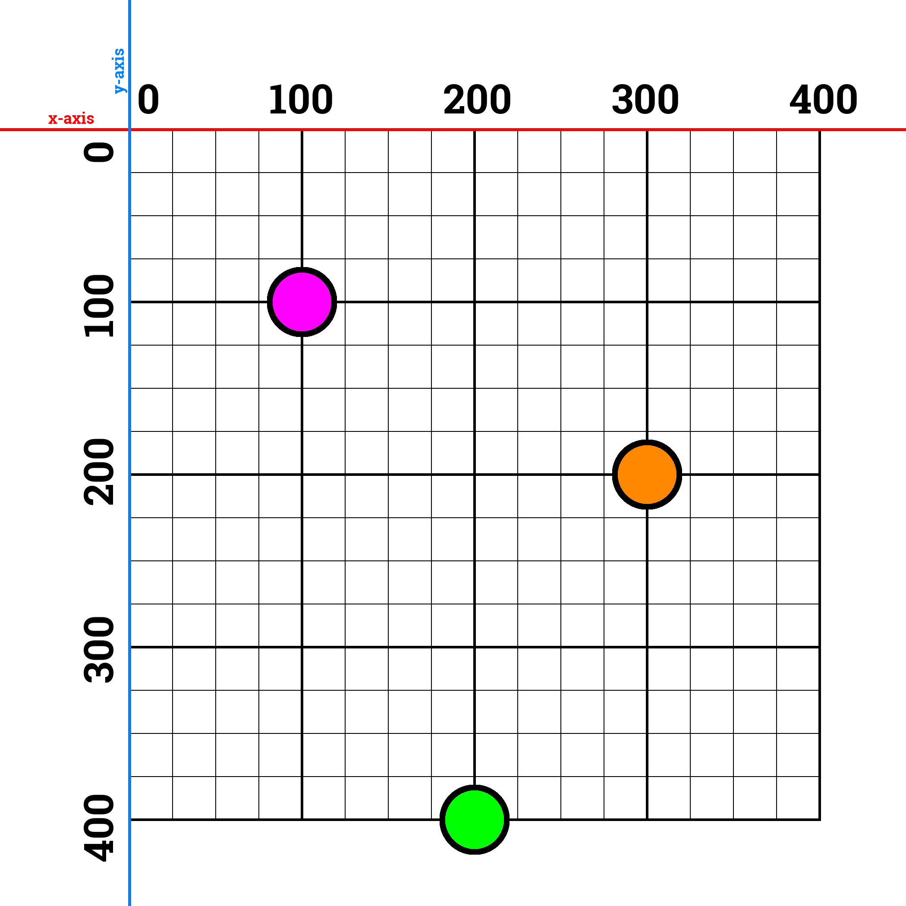

Slide 12
How to Draw Shapes

Slide 13
Line

Slide 14
Line
x2, y2
x1, y1

Slide 15
line – (100, 200) (50, 100)
line – 100, 200, 50, 100
line(100, 200, 50, 100);

Slide 16
Triangles
x2, y2
x1, y1
x3, y3

Slide 17
triangle – (100, 200) (50, 100) (200, 150)
triangle – 100, 200, 50, 100, 200, 150
triangle(100, 200, 50, 100, 200, 150);

Slide 18
Shape Modes
https://editor.p5js.org/crhallberg/sketches

Slide 19
Ellipse (CENTER)
x, y

Slide 20
Rectangles (CORNER)
x, y

Slide 21
Shape Commands
line (x1, y1, x2, y2);
ellipse (center x, center y, width, height);
rect (corner x, corner y, width, height);
triangle (x1, y1, x2, y2, x3, y3);
Time to make a house!

Slide 22
Notes:
https://tinyurl.com/imm120grid

Slide 23
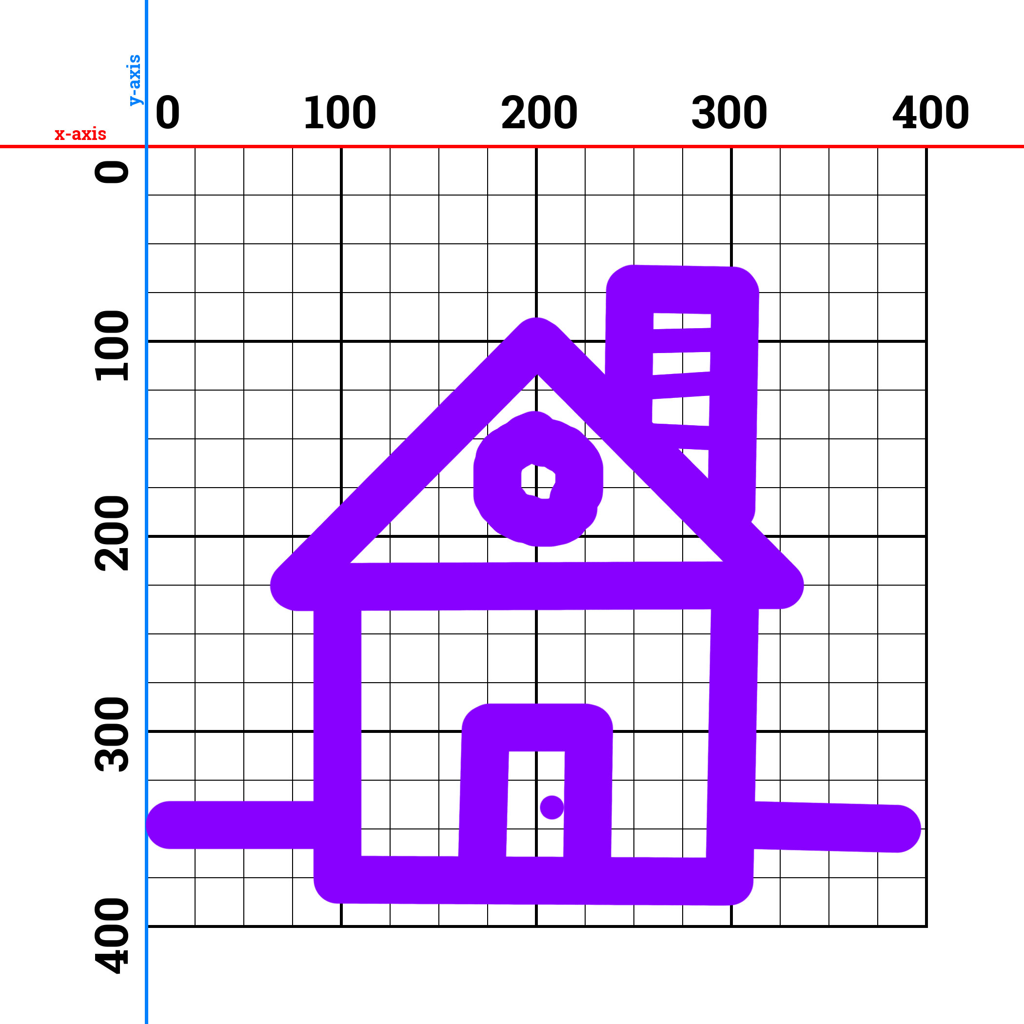

Slide 24
Layers
Shapes will be covered by shapes drawn later

Slide 25
Shape Commands
line (x1, y1, x2, y2);
ellipse (center x, center y, width, height);
rect (corner x, corner y, width, height);
triangle (x1, y1, x2, y2, x3, y3);
Time to make a house!

Slide 26
Using Colors
SAVE and make a new sketch

Slide 27

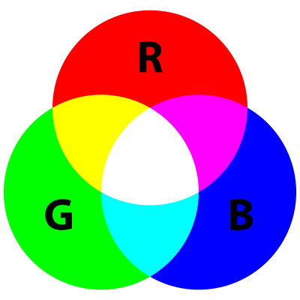

Slide 28
Red-Green-Blue
Just like coordinates are always in pairs, these go in triple.
Values go from 0 to 255. (it’s a binary thing)
If you only put one, p5.js will put that number in all three.
Use a color picker.

Slide 30
fill(255, 0, 0);
fill(255, 255, 0);
fill(0, 255, 0);
fill(255, 0, 255);
fill(0, 0, 255);
fill(0, 255, 255);

Slide 31
Color Commands
fill – inside color of the following shapes
stroke - line color of the following shapes
background – clear the entire screen w/ one color
background(100, 100, 100) == background(100)

Slide 32
When to Change Colors
BEFORE the shape you want to color
Color will not change until you tell it to
SETUP
DRAW

Slide 33
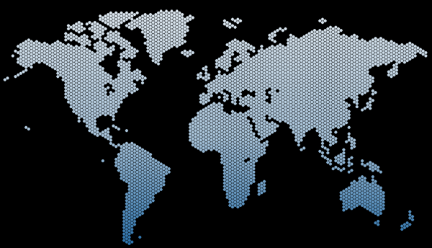
WELCOME TO THE
IMM 120 WORLD TOUR
Notes:
I’m going to name a country and I want you to draw the flag

Slide 34

JAPAN

Slide 35
Centering
createCanvas(width, height);
width
height
ellipse(width / 2, height / 2, ###);

Slide 36
noFill() and noStroke()
Draw a shape with no fill or stroke
Background and shapes behind will show through

Slide 37

DENMARK

Slide 38
DENMARK

Slide 39
DENMARK
Notes:
Off the screen (round ends)

Slide 40
Stroke Weight
Change the thickness of your lines
strokeWeight(pixels)

Slide 41

TRINIDAD AND TOBAGO

Slide 42
TRINIDAD AND TOBAGO

Slide 43
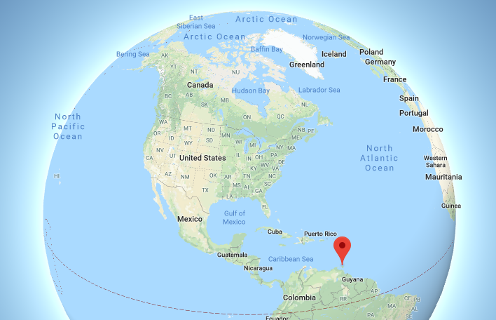
TRINIDAD AND TOBAGO

Slide 44

SAINT LUCIA

Slide 45
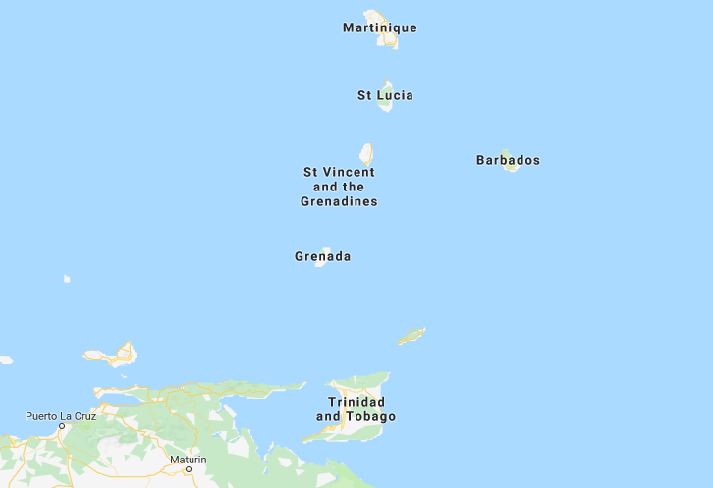
SAINT LUCIA

Slide 46

Choosing a Color From an Image

Slide 47

PAKISTAN

Slide 48
Occlusion
Use a shape with the background color to carve out a shape

Slide 50
Polygons
beginShape and endShape
Worth a read on the reference
I will touch on it in a later class

Slide 51
Homework #1
Take your house and submit the link on Canvas.

Slide 52
Homework #2
Play a clicker game
Universal Paperclips
Cookie Clicker
Eggs Inc.
Notes:
Abyssrium - Anne

Slide 53
Minute Surveys
Once you hand in your survey, you may go.
If you have questions or concerns, I will stay and answer them for as long as I can.
Notes:
Pink backgrounds - Charlotte

